Slide 1
Online Shoppers Intentions Predicting whether online shopper will generate revenue for the company or not.
project by Arnav saini

Slide 2
Problem Statement :
This is the data of an online retailing company where they are trying to find which online shopper will generate revenue by his/her online shoppers’ activity on their site.
We will be using Multiple features to predict the categorical variable
i.e. Revenue ( Target Variable).
We have feature like Bounce rate , Exit rate , page Value, Traffic type, Region to predict Target variable.

Slide 3
Pre-processing Steps Used
We have 123380 rows and 18 columns .
Revenue is our Target Variable which has two category.
We have 18 features out of which 2 are of Object Datatype while
rest are int, float and bool.
There are no Null values in the Dataset .
Treated Outliers using ‘Zscore’ method.
Shape of Dataset with Outlier = (12330,18)
Shape after treating Outlier =(9575,18)
Using Correlation Matrix , we can conclude how variables are related to each other , No feature has value above 0.7 in correlation Matrix.
Figure below:

Slide 4
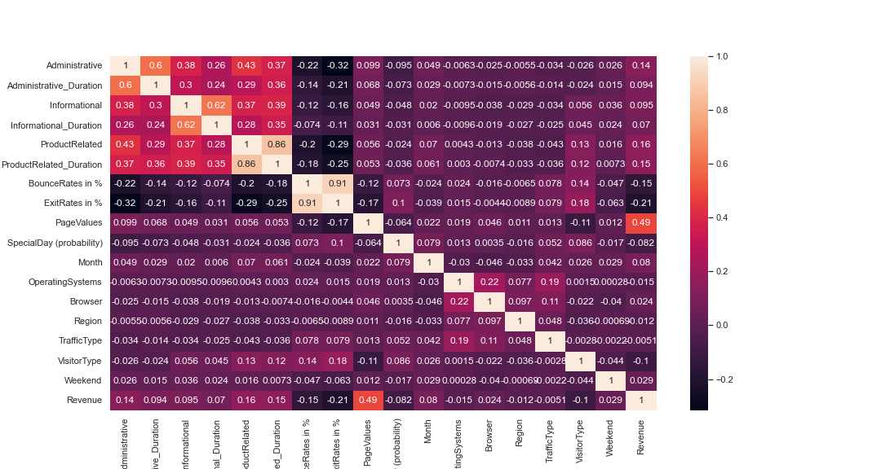

Slide 5
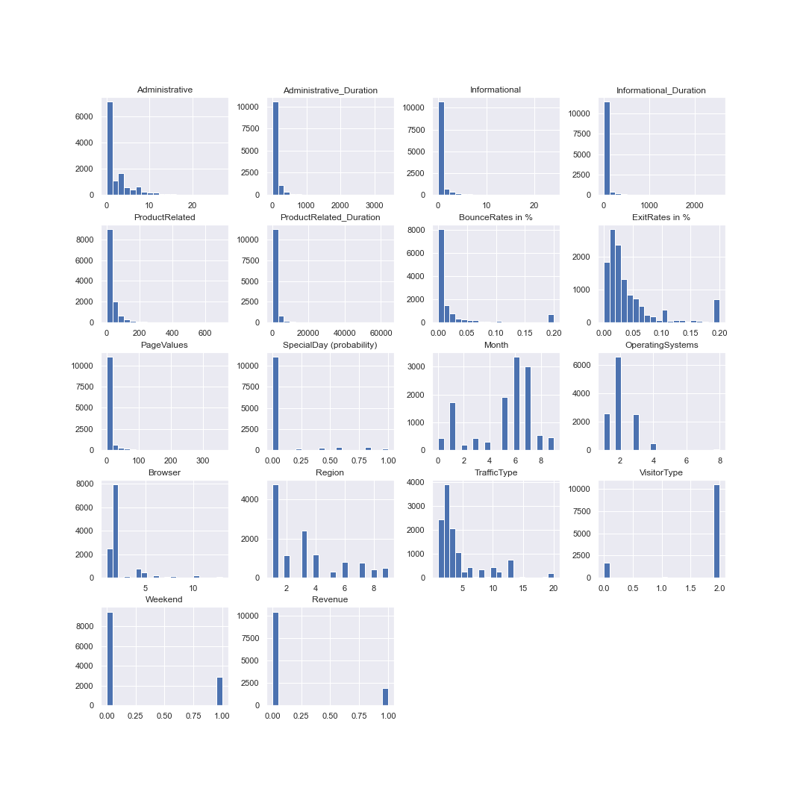

Slide 6
Model selection
There is class imbalance in the dataset so I have predicted Target variable with and without solving the problem to get Comparative analysis.
# Without solving Class imbalance Problem:
LogisticRegression Test Accuracy : 0.8939014202172096
DecisionTreeClassifier Test Accuracy : 0.8675856307435255
ExtraTreeClassifier Test Accuracy : 0.8492063492063492
RandomForestClassifier Test Accuracy : 0.9035087719298246
AdaBoostClassifier Test Accuracy : 0.8951545530492899
GradientBoostingClassifier Test Accuracy : 0.9001670843776107
SVC Test Accuracy : 0.8500417710944027
KNeighborsClassifier Test Accuracy : 0.8680033416875522
GaussianNB Test Accuracy : 0.83375104427736
BernoulliNB Test Accuracy : 0.8625730994152047

Slide 7
Random Forest classifier and Gradient boosting classifier is giving us the best accuracy
of 90 % ,let's try some other evaluation matrix to evaluate the model further.
As it is a Classification problem, Accuracy alone is not enough to pick the Final Model.
We have to use concept of Precision ,Recall , f1-score, confusion matrix to get proper understanding
# Classification Report :
Precision recall f1-score support
0 0.92 0.96 0.94 2035
1 0.72 0.54 0.62 359
Here we can clearly see the Precision and recall of class 1 is less because of class imbalance.
Confusion matrix and Roc curve below:

Slide 8
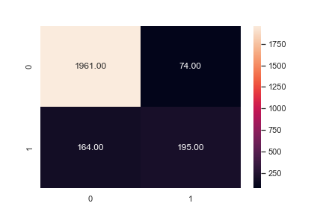

Slide 9
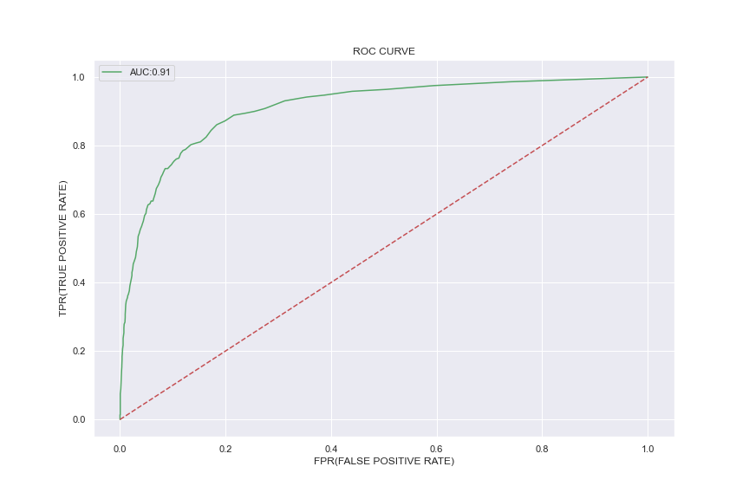

Slide 10
# Taking 2nd Scenario i.e. after solving class Imbalance Problem
Using RandomOverSampler from imblearn which will make minority class equals to majority class .
New shape of dataset = (16408,18)
Result for LogisticRegression Test Accuracy : 0.8074110190151146
Result for DecisionTreeClassifier Test Accuracy : 0.9556313993174061
Result for ExtraTreeClassifier Test Accuracy : 0.947586543149683
Result for RandomForestClassifier Test Accuracy : 0.9646513895660653
Result for AdaBoostClassifier Test Accuracy : 0.8403217942467089
Result for GradientBoostingClassifier Test Accuracy : 0.8605558264261336
Result for SVC Test Accuracy : 0.7208678693320332
Result for KNeighborsClassifier Test Accuracy : 0.855680156021453
Result for GaussianNB Test Accuracy : 0.7564602632862019
Result for BernoulliNB Test Accuracy : 0.7998537298878596
# Here we can see that Test accuracy has further increased to 96% in Random Forest classifier.

Slide 11
# Confusion matrix:
Precision Recall f1-score support
0 1.0 0.93 0.96 2087
1 0.93 1.0 0.97 2015
Here we can clearly see that the precision and recall of class 1 has significantly improved .
Let’s look at Confusion Matrix and ROC curve for the same;

Slide 12
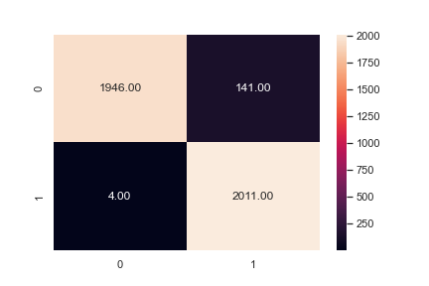

Slide 13
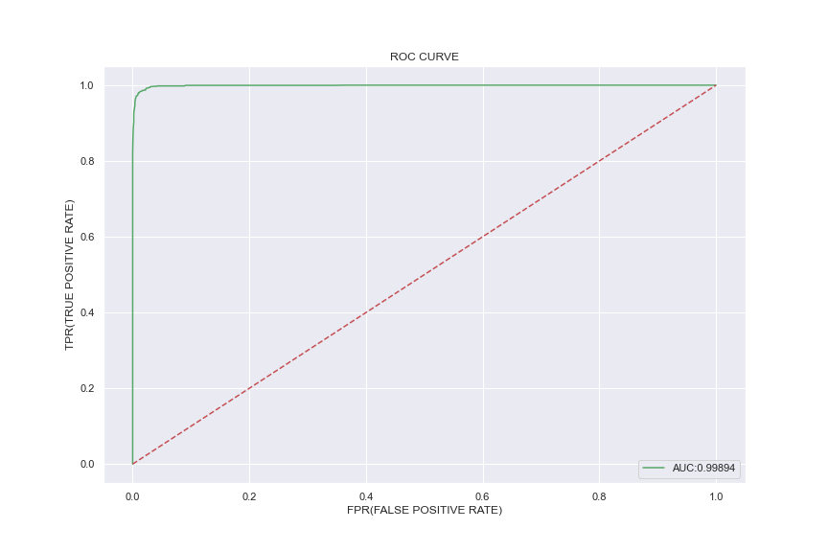

Slide 14
Difficulty faced :
There were 2 categorical variable and 2 Boolean variable which needs to be converted to numerical value .
I have used Label Encoder to do the same .
There was class Imbalance problem which I solved using Random over sampler.
I have treated Outliers using Zscore method .
# CONCLUSION :
Was able to build a model that predicts with an accuracy of 90 % with class imbalance
And gave accuracy of 96.5 % after fixing class imbalance with good Recall and Precision.
# model Selected : Random Forest Classifier

